Slide 1
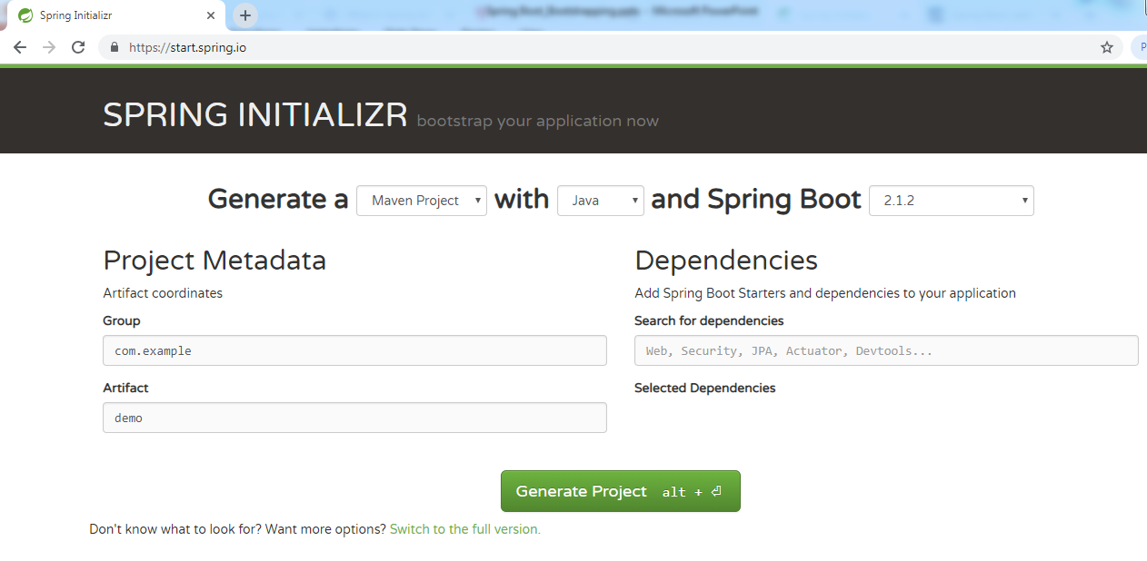
Spring Boot - Bootstrapping
One of the ways to Bootstrapping a Spring Boot application is by using Spring Initializer.
To do this, you will have to visit the Spring Initializer web page www.start.spring.io and choose your Build, Spring Boot Version and platform. Also, you need to provide a Group, Artifact and required dependencies to run the application.

Slide 2
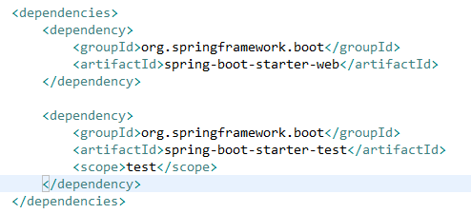
Spring Boot - Bootstrapping
Spring Boot provides a number of Starters to add the jars in our class path. For example, for writing a Rest Endpoint, we need to add the spring-boot-starter-web dependency in our class path.

Slide 3
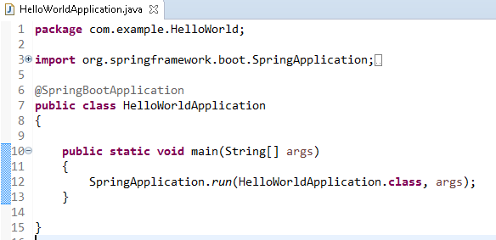
Spring Boot - Bootstrapping
HelloWorldApplication is the entry point of the spring boot application to start

Slide 4
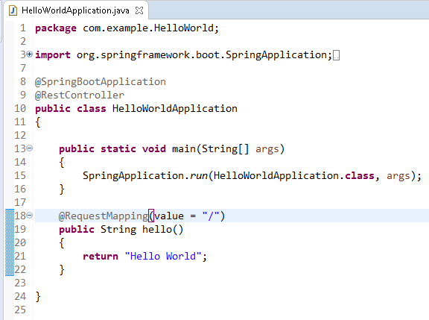
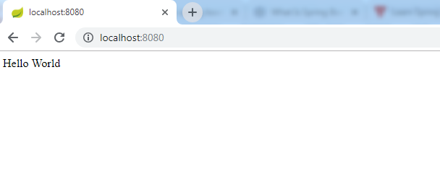
Spring Boot - Bootstrapping

Slide 5
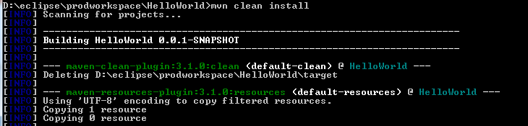
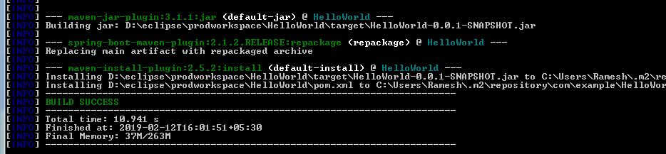
Spring Boot - Bootstrapping
Create an Executable JAR

Slide 6
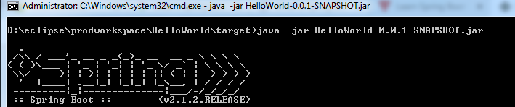
Spring Boot - Bootstrapping
Run Hello World with Java

